Slide 1

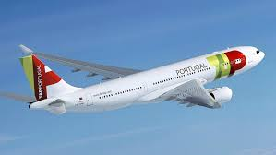
Executive Summary Airline Safety, Aviation Safety Network
By Soukhna Wade
DSC640
Bellevue University
Notes:
Hi, this presentation is all about airplane safety. We will be reviewing the safest and dangerous airlines.

Slide 2
Initial Airline Dataset:
1985-1999 and 2000-2014
Notes:
Here is the Initial airline dataset through 1985-1999 and 2000-2014

Slide 3
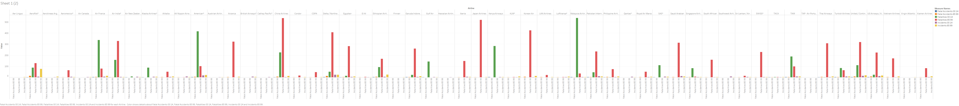
Graph
Notes:
The graph shows fatal accident fatalities and incident of the Airline industry from 1985-2014
China Airlines has the most fatalities, so it is not recommended to go there or any of the airlines shown in the graph.

Slide 4
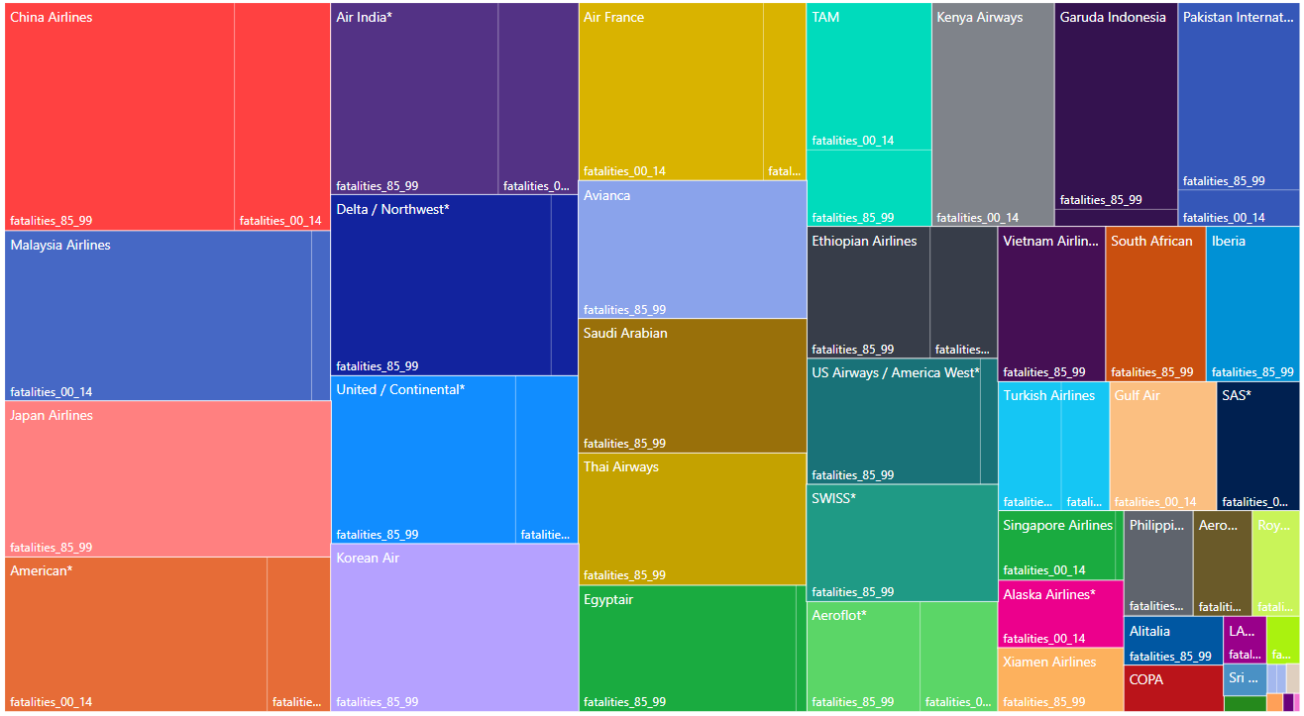
Fatalities
The first five airlines with higher fatalities are China Airlines, Malaysia Airlines, Japan Airlines, America Airlines, and Air India.
Notes:
The tree map at the bottom gives a clearer vision showing the dangerous and safer side of airlines.

Slide 5
Fatalities
Airlines | 1985-1999 |  |  | 2000-2014
airline | incidents_85_99 | fatal_accidents_85_99 | fatalities_85_99 | incidents_00_14 | fatal_accidents_00_14 | fatalities_00_14
China Airlines | 12 | 6 | 535 | 2 | 1 | 225
Malaysia Airlines | 3 | 1 | 34 | 3 | 2 | 537
Japan Airlines | 3 | 1 | 520 | 0 | 0 | 0
American* | 21 | 5 | 101 | 17 | 3 | 416
Air India* | 2 | 1 | 329 | 4 | 1 | 158
Notes:
Reading the bar graph China Airlines, Malaysia Airlines, Japan Airlines, American Airlines and Air India have higher fatalities.

Slide 6
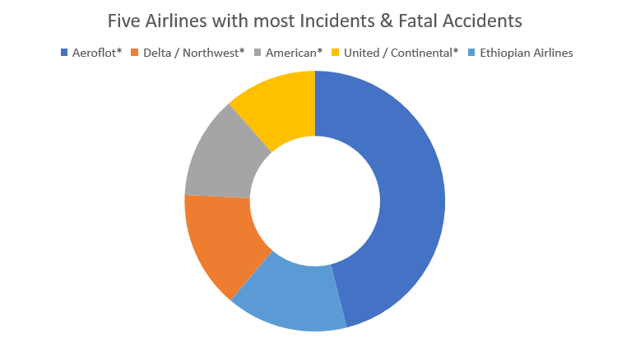
Incidents & Fatal Accidents
Airlines | incidents_85_99 | fatal_accidents_85_99 | fatalities_85_99 | incidents_00_14 | fatal_accidents_00_14 | fatalities_00_14
Aeroflot* | 76 | 14 | 128 | 6 | 1 | 88
Delta / Northwest* | 24 | 12 | 407 | 24 | 2 | 51
American* | 21 | 5 | 101 | 17 | 3 | 416
United / Continental* | 19 | 8 | 319 | 14 | 2 | 109
Ethiopian Airlines | 25 | 5 | 167 | 5 | 2 | 92
Notes:
The Donut chart shows the five Airlines with most Incidents & Fatal Accidents

Slide 7

Fatalities & Incidents
Notes:
Aside from the bar graph, the pie chart shows Aeroflot has the most fatal accidents, with Delta/Northwest behind it.

Slide 8
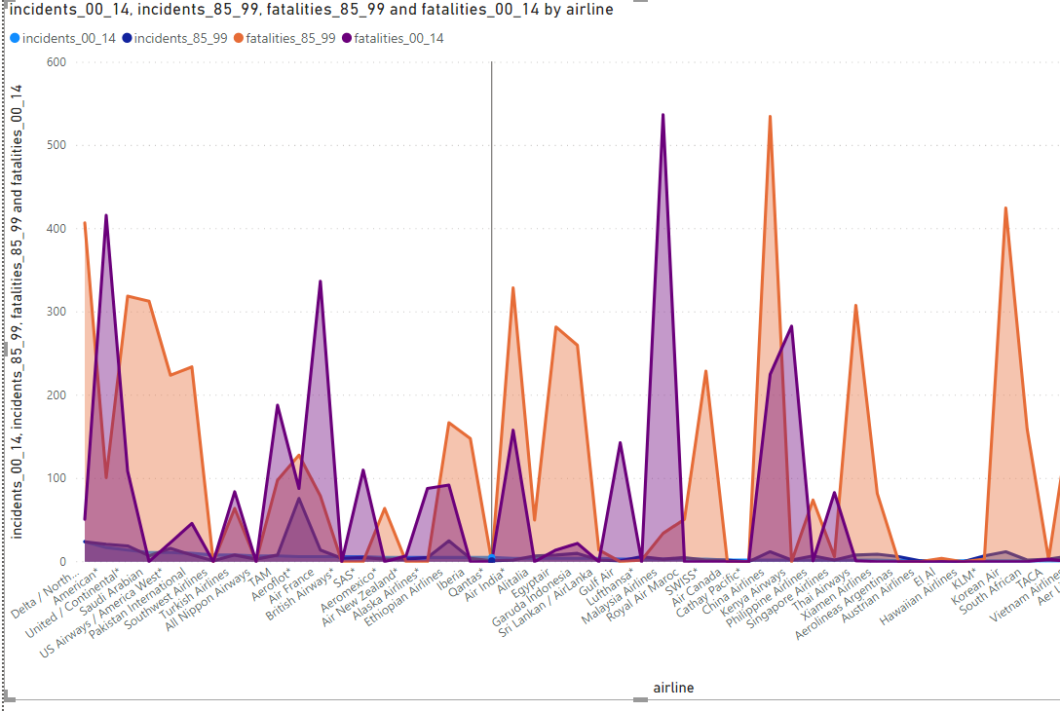
Incidents and Fatal Accidents From 1985 to 2014
Notes:
Reading through all the charts, it is prevalent that China Airlines is the most unsafe airline, having higher fatality rates than any other airline, and TAP airlines is the safest having a low fatality/incident rate, only having one. The next safest airline is Virginian Atlantic, Hawaiian Airlines, and Finnair.

Slide 9
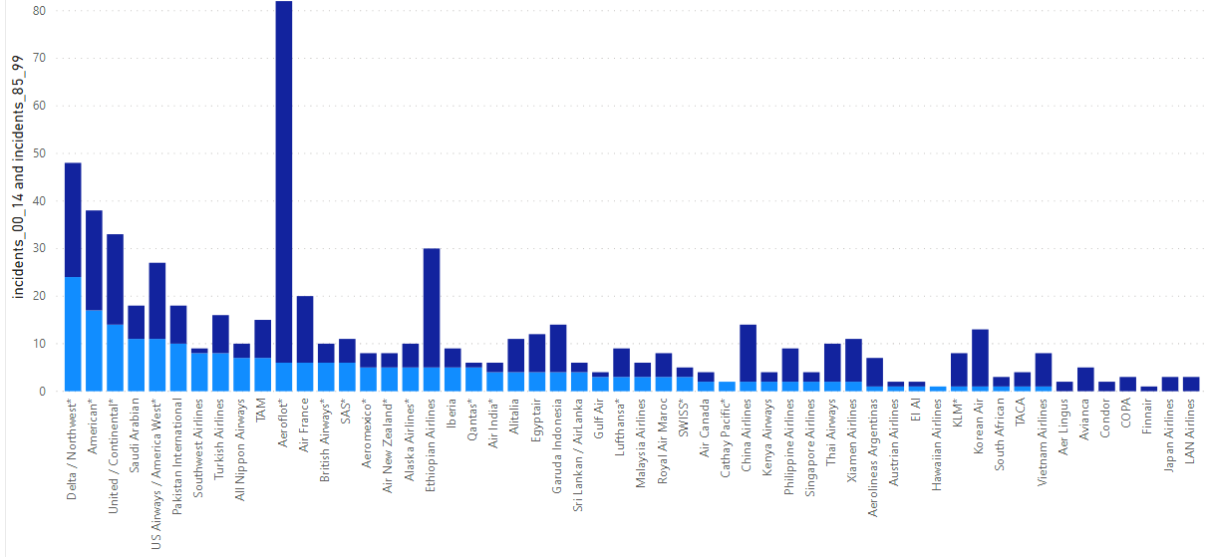
Airplane Safety
The safest airline is TAP-Air Portugal, TAP has one of the best safety records of any airline in the list with only one incidence between 1985 to 2014; follows by Virginian Atlantic, Hawaiian Airlines, Finnair.
Notes:
Reading through the charts, it is noticeable that TAP Portugal Airlines has the lowest fatality and incident rate, making it the safest of all.

